Slide 1

LAB SQL 06 Database(s): salesshort Lab goals. Use subqueries with either your local MySQL Community Server instance or the on-premise MySQL server at Leeds. If you use your local MySQL Community Server instance, you will need to load the salesshort database into your local instance using the .sql file: S02 salesshort.sql. Remember to select ‘Don’t Limit’ to ensure your query results are not being limited to the first 10, 50, 100 rows, etc…
If you are still troubleshooting any part of the MySQL installation process and/or connection to the MySQL server instance at Leeds, please reference this PowerPoint. You can also use MySQL in phpMyAdmin as a demo.
MSBX-5405
Originally created by: Dr. Karina Hauser
Modified by: Keith Sparling

Slide 2
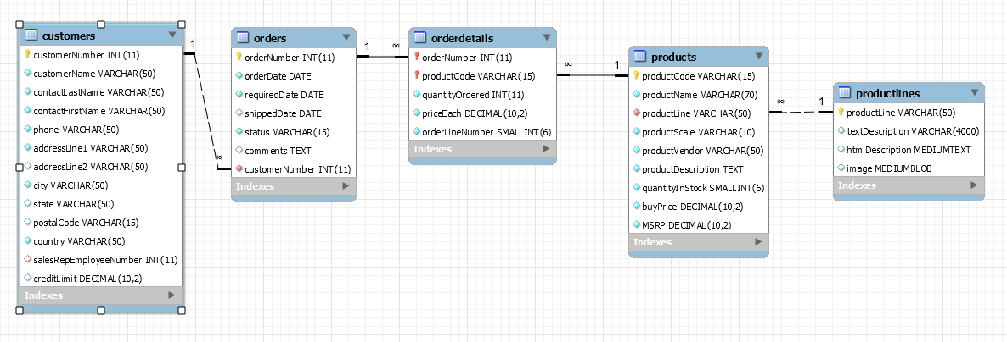
ER Diagram for SalesShort Database

Slide 3
LAB SQL 06 Save a .sql script labeled: lab06_”your IdentiKey” (for example: lab06_kesp5555)
Write SELECT statements to answer the following using subqueries…
Show all the orders where quantityOrdered is larger than the average quantityOrdered. Show the customerNumber, customerName, orderNumber, sum (quantityOrdered), and average (quantityOrdered). Order by customerName.
Show the customer with the most ‘revenue’ (i.e., ‘revenue’ = quanitityOrdered * priceEach). Show the customerNumber, customerName, and ‘revenue’ columns. Make sure that if two or more customers have the same ‘revenue’, both/all ties are listed.
Show the top three customers based on ‘revenue’. Show the customerNumber, customerName, and ‘revenue’ columns. Make sure that if two or more customers have the same ‘revenue’, both/all ties are listed.

Slide 4
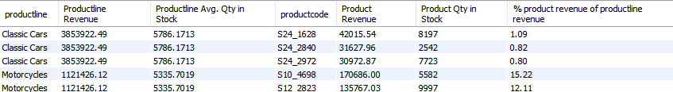
LAB SQL 06 Save a .sql script labeled: lab06_”your IdentiKey” (for example: lab06_kesp5555)
Show all customers whose ‘revenue’ is more than 30% above the average ‘revenue’. Show the customerNumber, customerName, ‘revenue,’ and the following calculated field: average revenue + 30% (i.e., 30% above the average ‘revenue’ = average (revenue) * 1.3). Order by customer ‘revenue’ (highest to lowest).
Show the ‘revenue’ per productLine, average quantityInStock per productLine, ‘revenue’ per productCode, and average quantityInStock per productCode. Show the productCode’s ‘revenue’ as a % of the productLine’s ‘revenue’. Order by (1) the productLine and then (2) the productCode’s ‘revenue’ as a % of the productLine’s ‘revenue’.
You should get 109 rows returned in your results. Here is a sample of some of those results:

Slide 5
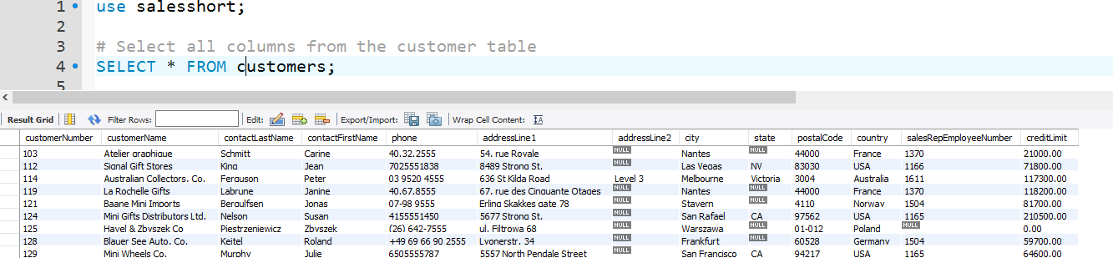
Submit the following:
One .sql file with your 5 SQL scripts.
OPTIONAL…a word document, PDF, or PowerPoint with screenshots of your SQL code and the first 10 - 20 lines of output for each of your 5 SQL scripts (i.e., select statements). Example:
This lab assignment will be reviewed by two peers, taking the average score from these two peer reviews, based on (1) the ability to execute/run each select statement and (2) the “recommended” output for each select statement.

